Slide 1
Executive Summary
DSC 640 | Lara Clasen

Slide 2
Trends in Airline Safety
In the following slides I will present visualizations to help narrate our understanding of the current airline safety trends. Our airline safety data ranges from 1985 through 2014, with two buckets of data separating 1985-1999 and 2000-2014. We are able to gain some insight by looking at our data alone, as well as by looking at some related outside data sources.
This helps us get perspective on the current trends in airline safety as it applies to incidents and fatalities. We know from recent events that the public perspective may be skewed, and it is up to us to attempt to reorganize public views of airline safety in terms of realistic risks.

Slide 3
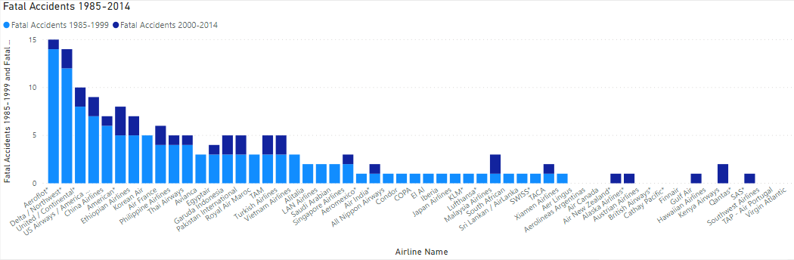
Fatal Accidents by Airline 1985-2014
The above visual is a stacked column chart displaying fatal accidents by airline for each of our year-range buckets. We can quickly see that in general our earlier bucket comprises much of the chart, suggesting that the number of fatal accidents per airline has generally decreased within the later bucket of years.

Slide 4
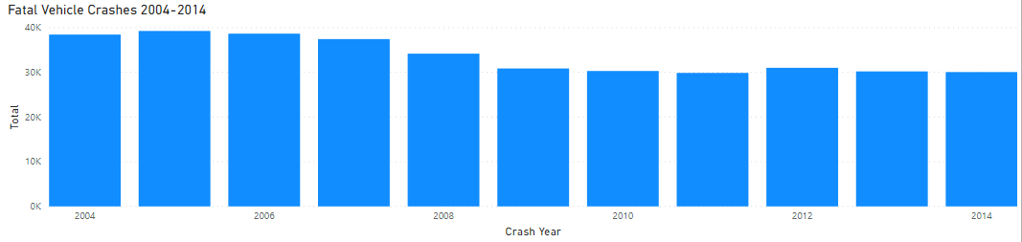
Fatal Vehicle Crashes 2004-2014
Our next visualization uses an outside data resource which tells us the number of fata vehicle crashes. Our time frame for comparison is nearly identical to our later year-range bucket, ranging from 2004 through 2014. We immediately see that the numbers for vehicle crashes are greatly increased as compared to that of airline fatal accidents. [https://cdan.dot.gov/query]

Slide 5
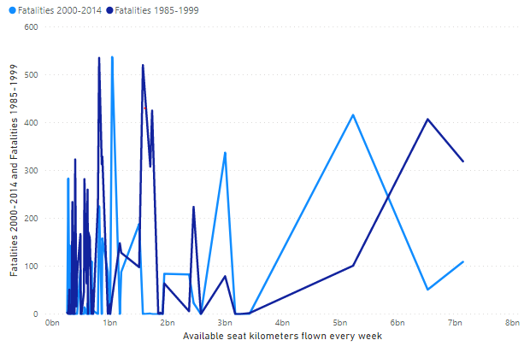
Fatalities by Available seat kilometers flown per week 1985-1999 and 2000-2014
To the right is a chart displaying the number of fatalities for both year-range buckets as related to the number of available seat kilometers flown every week. This gives us a different perspective of the fatalities. This metric measures passenger carrying capacity and is equal to the number of seats available multiplied by the number of miles or kilometers flown. We should hope to see that airlines with a greater ASK would have a lower accident rate as they tend to carry a greater number of passengers.

Slide 6
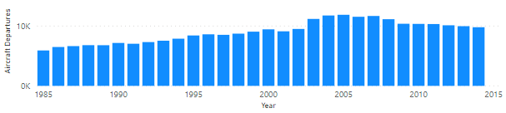
Departures by Airline 1985-2014
This display comes from an outside resource and tells us simply the number of aircraft departures per year. We can see that the number of departures trends up steadily until about 2007, at which point it declines at a less rapid rate continuing until 2014. This suggests a decrease in customers flying overall but would require more research to understand other potential reasoning.
[https://www.airlines.org/dataset/annual-results-u-s-airlines-2/]

Slide 7
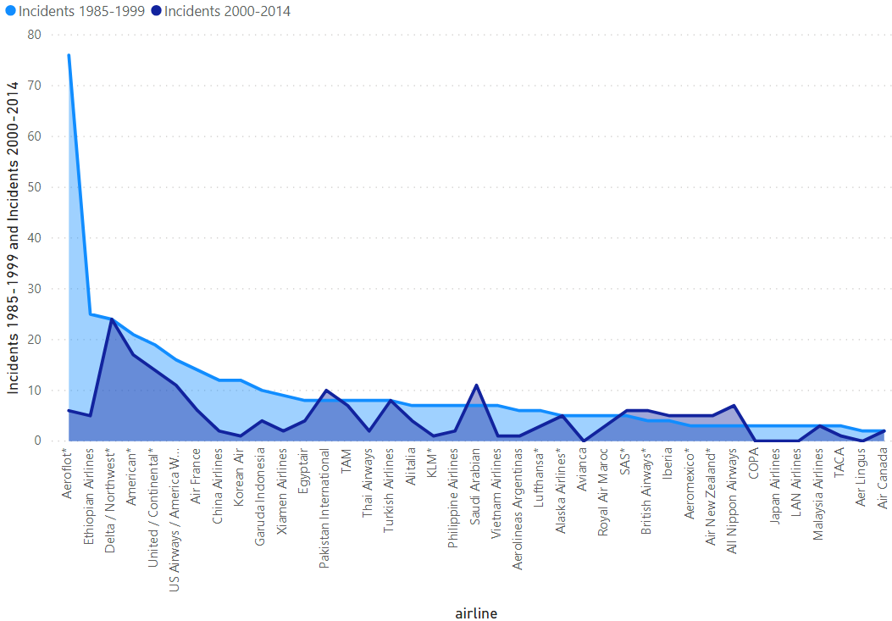
Incidents by Airline 1985-1999 and 2000-2014
The area chart here shows us the number of general incidents by airline for our two year-range buckets. The numbers for our first bucket as compared to our second bucket are noticeably higher, showing definitively that those numbers have declined greatly in recent years.

Slide 8
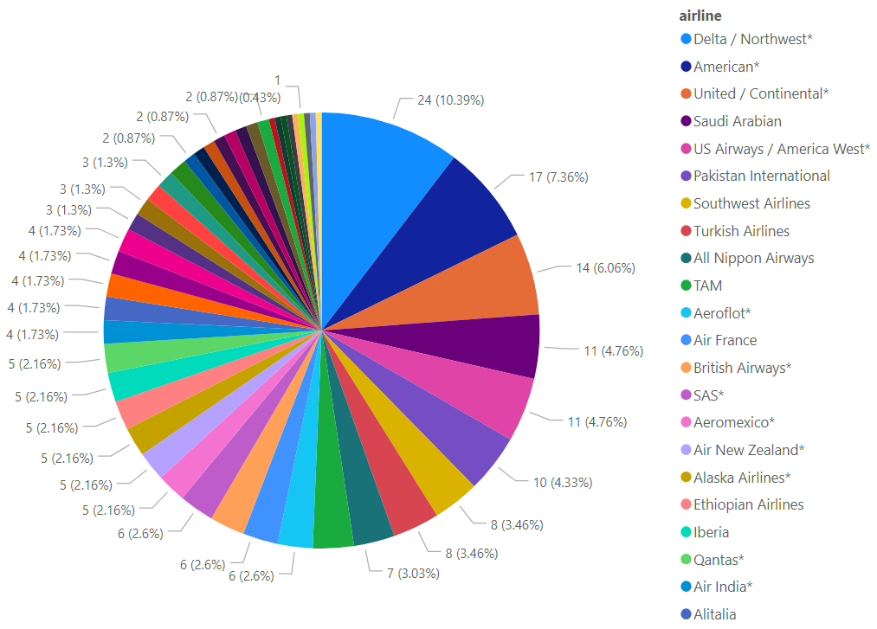
Incidents by Airline 1985-1999 and 2000-2014
This variation is simply an easy way to see which of our studied airlines is comprising how much of the total number of incidents within our later date range of 2000-2014. This chart is best for top-line visualization but will require further information. For example, Delta may lead in number of incidents, but this is likely attributed to the airline's higher overall activity during these years as compared to other airlines.

Slide 9
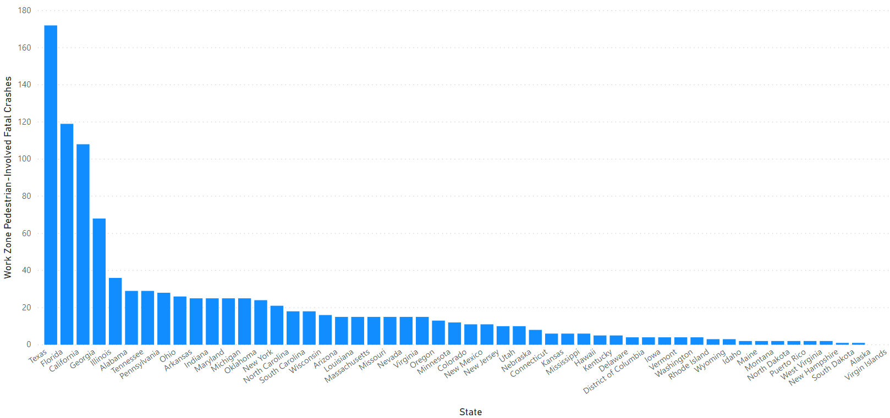
Work Zone Pedestrian-Involved Fatal Crashes 2009-2016
Finally, while this chart offers a differing year range than our previous data, it gives us a new comparison of fatal accidents that is slightly different than our airline or vehicle numbers. This chart shows us the number of work zone fatalities involving pedestrians by state for the years 2009-2016.

Slide 10
In summary…
The presented visualizations aim to highlight airline safety in terms of incidents and fatal accidents. We have looked at the number of those incidents by airline, as well as across several date ranges. This gives us the ability to state undeniably that airline safety has improved drastically in recent years. By comparing these values to those of automobile incidents in similar date ranges, we can see that by comparison airline travel experiences far fewer incidents than do vehicle accidents, fatalities included.
I believe that the most important piece of information to gain from this overall is that airline travel is by far a safer mode of transportation as compared to other everyday methods. When we compare airline travel to that of both automobile and one aspect of pedestrian travel, we see evidence of a greatly decreased risk when travelling by air. This provides us with crucial data to bring to the public eye to offer fresh perspective on the benefits, rather than the risks, of air travel. We have the opportunity to bring new light to the advantages of travelling by plane in today’s world
The next step would be to compare the safety statistics for each airline to one another. Ultimately, we can determine the relatively safest, and riskiest, airline to select for travel. As employees of a single airline involved in these results, we want to identify where our airline falls in terms of safety as compared to the others. From here we will be able to best determine our route of public outreach.

